Slide 1
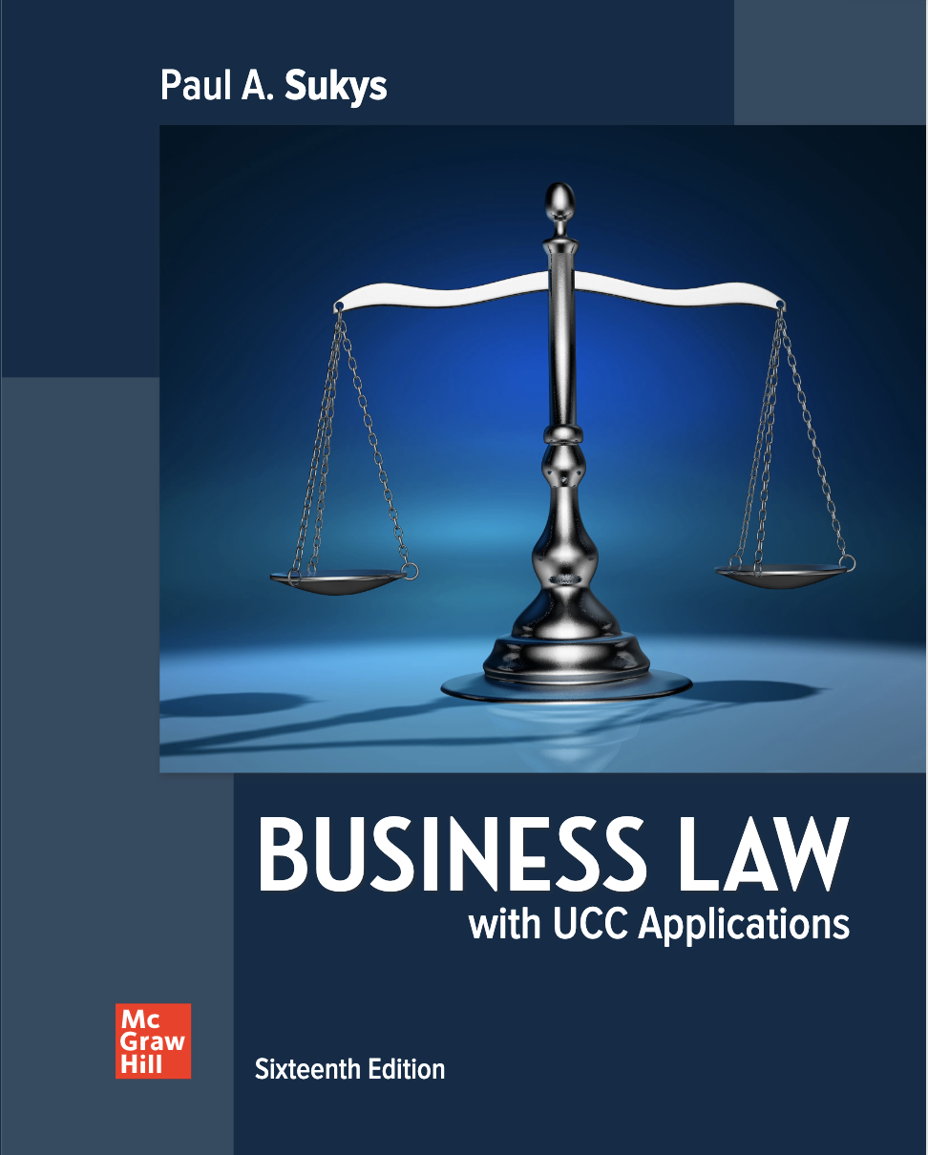
Ethics and the Law
Chapter 1
© McGraw Hill LLC. All rights reserved. No reproduction or distribution without the prior written consent of McGraw Hill LLC.

Slide 2
Learning Objectives
Define law, morality, and ethics.
Distinguish between traditional natural law and modern natural law.
Distinguish between nonjudgmentalism and hyper-intolerance.
Describe social contract ethics.
Outline the steps in applying utilitarianism.
Define rational ethics.

Slide 3
Learning Objectives (continued)
Explain the dyadic nature of ethics in government.
Explore the need for ethical responsibility in business.
Describe the need for law in our society.
Clarify how the law and ethics can often benefit from anarchy.

Slide 4
Question (1)
What defines the duties and rights of the people?
  A. Ethics
  B. Values
  C. Morals
  D. Law
Notes:
The correct answer is “D” – law. See the next slide.

Slide 5
The Law and Morality
The law.
  Consists of rules of conduct established by the government of a society to maintain harmony, stability, and justice.
  Defines the duties and rights of the people.
  Provides a way to protect the people by enforcing these rights and duties.
  Is a means of civil management.
Notes:
Teaching Tips
The use of fetal tissue for medical treatment is at the center of a fiery debate. Discuss the topic in class. Then ask the students to analyze it from a viewpoint of subjective ethics.

Slide 6
Question (2)
What are values that govern the difference between right and wrong and good and evil?
  A. Morals
  B. Ethics
  C. Societal values
  D. Law
Notes:
The correct answer is “A” – morals. See the next slide.

Slide 7
The Law and Morality (continued)
Morals.
  Values that govern the difference between right and wrong and good and evil.
  Serve as a guide for those bodies that make, interpret, and enforce the law.

Slide 8
Values and Ethics
Ethics.
  The attempt to develop a means of determining what fundamental values really are and for formulating and applying rules that enforce those values.
Notes:
Background Information
The tendency to complicate moral decision making is nothing new. In her essay, “The Moral Life,” Bonnie Kent, a professor of philosophy at the University of California, Irvine, reminds us that even medieval philosophers tended to complicate the rules of moral judgment.

Slide 9
Traditional Natural Law
Sees law as originating from some objective, superior force that stands outside the everyday experience of most people.
There exists an unbreakable link joining morality to the law in a fundamental way.

Slide 10
Question (3)
Which theory strives to have an objective standard of human morality with its origin point conceived of by the human mind?
  A. Traditional natural law
  B. Modern natural law
  C. Nonjudgmentalism
  D. Judgmentalism
Notes:
The correct answer is “B” – law of peoples. See slide 1-14.

Slide 11
Modern Natural Law
Legal theory that says that the law originates from an outside source that has emerged from within society.

Slide 12
Nonjudgmentalism
Results from a good-natured attempt to understand another person’s behavior.
Originates in a culture that wants tolerance to be one of its highest virtues.

Slide 13
Nonjudgmentalism (continued)
Problems with nonjudgmentalism.
  Tolerance often degenerates into the intolerance of those who refuse to tolerate the behavior in question.
  The expression of nonjudgmentalism is illogical and self-contradictory.
  To avoid being judgmental, non judgmentally must be morally neutral on all types of behavior.
  Moral nonjudgmentalism is a slippery slope.

Slide 14
Hyper-Intolerance
Just as damaging as nonjudgmentalism.
  Defined as open hostility to the views, ideas, traditions, principles, and beliefs held and practiced by others.
  Makes civil discourse about moral problems difficult, uncomfortable, and, at times, virtually impossible.

Slide 15
Ethical Decision-Making
Some people say that they do not think about ethics but instead act instinctively when faced with a moral problem.
Others say that they just do what they “believe” is right.
Others say that they follow the rules they learned in school, in their place of worship, or in their family setting.
Some professions, businesses, and organizations develop guidelines, usually called rules of conduct or canons of professional responsibility.

Slide 16
Ethical Theories: The Social Contract Option
Social contract ethics.
  Hold that right and wrong are measured by the obligations imposed on each individual by an implied agreement among all individuals within a particular social system.
Notes:
Teaching Tips
Discuss examples from recent events that involve moral atrocities committed by individuals whose moral code should have forbidden such actions. Ask the following question: What brings about dishonorable actions, such as the shameful treatment of Arab prisoners at Abu Ghraib prison in Iraq during Gulf War II?
Teaching Tips
Consider using the following films to generate a discussion about ethics and the application of ethical theories: Crash (starring Sandra Bullock and Matt Dillon), Babel (Cate Blanchett), Bobby (Emilio Estevez, Anthony Hopkins, and Martin Sheen), The Good Shepherd (Matt Damon and Robert DeNiro), Hoax (Richard Gere), Hollywoodland (Ben Affleck and Diane Lane), The Pursuit of Happyness (Will Smith), The Queen (Helen Mirren), and Syriana (George Clooney). Create a list of study questions for each film to make sure students focus on relevant issues.

Slide 17
Shortcomings of Social Contract Ethics
For the social contract to work, most people must adhere to its rules, and those who do not must be punished.
Social contract ethics is descriptive rather than prescriptive.
Notes:
Naturally, for the social contract to work, most people must adhere to its rules, and those who do not must be punished. If this were not the case, then the social contract would disintegrate, and the society would return to a “state of nature” in which people must fend for themselves.
Another problem is that social contract ethics is descriptive rather than prescriptive. A descriptive theory simply describes the values at work within a social system, rather than explaining how the values originated in the first place. In contrast, a prescriptive theory explains how to come up with the values that permit a society to run smoothly.

Slide 18
Question (4)
Which ethical theory calls for the greatest good for the greatest number?
  A. Totalitarianism
  B. Utilitarianism
  C. Unilateralism
  D. Multiplicity
Notes:
The correct answer is “B” – utilitarianism. See slide 1-19.

Slide 19
Ethical Theories: The Utilitarian Option
Utilitarianism.
  The morality of an action is determined by its ultimate effects.
  Greatest good for the greatest number.

Slide 20
Ethical Theories: The Utilitarian Option (continued)
One way to avoid mistakes that can result from an improper application of utilitarianism is to follow these steps:
The action to be evaluated should be stated in unemotional, general terms
Every person or class of people that will be affected by the action must be identified
Good and bad consequences in relation to those people affected must be considered
All alternatives to the action stated in step 1 must be considered
Once step 4 has been carried out, a conclusion must be reached

Slide 21
Shortcomings of Utilitarianism
Failure to produce consistent moral judgments.
Development of a commonly understood definition of good.

Slide 22
Ethical Theories: The Rational Option
Rational ethics.
  Ethical values can be determined by a proper application of human reason.
  Should establish universal rules of behavior that apply to all people at all times.
  Also called objective ethics.

Slide 23
Shortcomings of Rational Ethics
Penumbra rights.
  Those that are found in those indeterminate or indistinct shadow areas associated with more uniformly accepted rights, such as the right to a safe and secure life.

Slide 24
Ethics and the Government
The government of a nation has two objectives that simultaneously justify its power and enable the proper exercise of that power.
  To protect its own existence.
  To protect the lives, health, and well-being of its own citizens.

Slide 25
A Governmental and Ethical Dyad
Ethic of ultimate ends.
  Must be practiced by individuals because individuals can never completely foresee “the ultimate ends” of their actions.
  Individuals must obey absolute moral precepts, such as “turn the other cheek” even though the ultimate consequences of those actions are unclear or uncomfortable.
  Often referred to as the ethic of benevolence.

Slide 26
A Governmental and Ethical Dyad (continued)
Ethic of responsibility.
  Demands that the moral actor, in this case a national leader, consider his responsibilities to those people who depend on that leader for safety and security.

Slide 27
Shortcomings of the Ethical Dyad
Leaders have difficulty executing the ethic of responsibility.
Leaders must adopt a far-reaching vision that measures what is best for the nation’s citizens in terms of what is best for the economic stability of the world.

Slide 28
The Threat of Failed States
Failed states.
  Those in which the government has completely collapsed or has become so ineffective that it can no longer provide sustenance or security for its own people.
Unstable states.
  Those in which the government suppresses its own people thus inviting a future revolt that might destabilized a region.
Rogue states.
  Those that have stepped outside the parameters of international law and have become veritable outlaws in the global community.
Notes:
People who live in those failed and unstable states may become so desperate they have nothing to lose by using violence.

Slide 29
The Responsibility to Protect (R2P)
Declares that the leadership of every nation has a definitive duty to protect its own people from four major threats, genocide, war crimes, ethnic cleansing, and crimes against humanity.

Slide 30
Ethics and Business
The traditional view says that privately owned corporations are created solely to make a profit for their shareholders.
The foremost job of any manager is to maximize profits.

Slide 31
Reasons for Ethical Responsibility
A corporation offers limited liability to owners.
A corporations is considered an artificially created person.
A corporation can own property and bring lawsuits to vindicate its rights.
Notes:
Teaching Tips
Explain to the students that communication between an attorney and a client is strictly confidential. There is one exception—when a client confides in his or her lawyer that he or she is about to commit a crime, the attorney has a legal duty to disclose this information to the police. Lead the class in a discussion of how serious a crime would have to be before the attorney has an ethical duty to act. Would the attorney–client privilege benefit proportionately if this exception were not in place?

Slide 32
Reasons for Ethical Responsibility (continued)
Corporate decision-making clearly has an impact on more people than just the shareholders and the managers.
Many stakeholder groups should be taken into consideration when corporate managers make decisions.
Accepting social responsibility is in the long-term interest of the corporation.

Slide 33
Efforts to Promote Ethical Behavior
Statutes now permit managers to consider factors other than profit in making decisions.
  Economic well-being of the nation, the state, and the local community.
  Interests of employees, consumers, and suppliers.
  The betterment of the environment, the economy, and the overall social structure.

Slide 34
The Relationship between Law and Ethics
The law is needed because, though people know better, they do not always follow ethical principles.
Ethical principles can tell us what is right but cannot stop us from doing wrong.
The law can punish us if we choose to do wrong.

Slide 35
Ethical and Legal Anarchy
Kropotkin and Jean Jacques Rousseau.
  Believed that a little anarchy now and again is useful, despite the horrors that often result in such a state, but only when what emerges from that period of anarchy is a system blessed by legal and ethical harmony.
Appretiare.
  Doing one’s duty in a cooperative and nonselfish way creates harmony in the society, evokes appreciation from other members of that society, and gives each person a feeling of self-worth that goes way beyond anything that mere money can do.

Slide 36
End of Main Content

